Slide 1
MINI PROJECT
2021-22

Slide 2

LIBRARY MANAGEMENT SYSTEM USING C
YASH TAYAL
COMPUTER SCIENCE AND ENGINEERING
2ND YEAR CSE-4
I M S ENGINEERING COLLEGE GHAZIABAD

Slide 3
INTRODUCTION
THIS PROJECT IS DEDICATED TO –
THIS IS THE DATA BASE PROJECT.
SIMPLIFY THE LIBRARY PROCEDURE.
TO PROVIDE A COMPREHENSIVE SET OF FEATURES.
EVALUATE THEIR FUNCTIONS IN DIFFERENT SCENARIOS.
SUGGEST MODIFICATION FOR GREATER EFFICIENCY.

Slide 4
OBJECTIVE
TO DEVICE SOFTWARE FOR PROVIDING THE INFORMATION AND SIMPLIFIES THE PROCEDURE TO RENEW AND SEARCH BOOKS

Slide 5
TOOLS & TECHNOLOGY
VS code
BASED ON C LANGUAGE

Slide 6
FLOW CHART
LIBRARY MANAGEMENT ADD ALL BOOKS IN LIBRARY BY BOOK-ID/BOOK NAME/YEAR
LIBRARY MANAGEMENT SEARCH THAT BOOK BY NAMAE OF THE BOOK
IF USER WANT TO SEE ALL AVAILABLE BOOK IN LIBRARY
USER ASK FOR ANY BOOK
THENLIBRARY MANAGEMENT EASILY SHOW ALL THE BOOKS TO THE USER
LIBRARY MANAGEMENT EASILY SEARCH /REMOVE /ADD ALL THE BOOK IN THE LIBRARY

Slide 7
EXISTING SYSTEM
FAST REPORT GENERATION IS NOT POSSIBLE.
TRACING A BOOK IS DIFFICULT.
INFORMATION ABOUT ISSUE OR RETURN OF THE BOOKS IS NOT PROPERLY MAINTAINED.

Slide 8
PROPOSED WORK OR FUTURE SCOPE
IT PROVIDES BETTER AND EFFICIENT SERVICE TO USERS.
REDUCE THE WORKLOAD.
FASTER RETRIEVAL OF INFORMATION ABOUT THE DESIRED BOOK.
PROVIDE FACILITIES FOR PROPER MONITORING , REDUCE PAPERWORK.
ALL DETAILS WILL BE AVAILABLE ON A CLICK.
BE QUICK AND MORE EFFICIENT.

Slide 9
FUNCTIONS / CODE
1. VOID ADD_BOOK()
2. VOID VIEW_BOOK()
3. VOID SEARCH_BOOK()
4. VOID DEL_BOOK()
5. VOID UPDATE()

Slide 10
REFERENCES
WITH THE HELP OF GOOGLE AND
GEEKSFORGEEKS

Slide 11
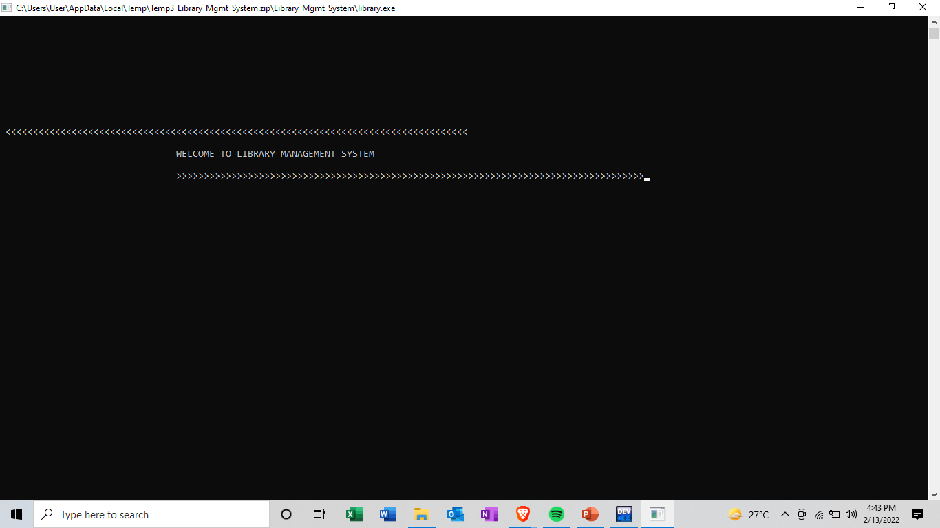
SCREEN SHORT OF THE PROJECT

Slide 12
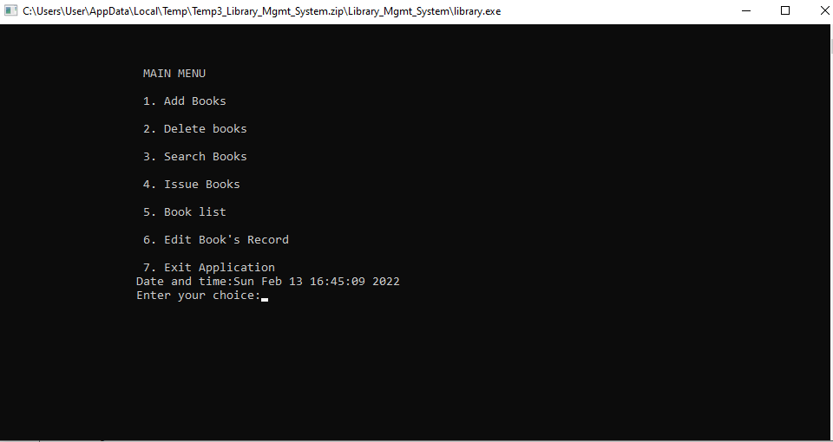

Slide 13
CONCLUSION
IT REDUCES THE PAPER WORK.
IT MAINTAINS THE POTENTIALLY VAST AMOUNT OF BOOKS HELD IN THE LIBRARY.
IT REDUCES HUMAN EFFORTS.
IT REDUCES TIME SPAN.
EVENTUALLY INCREASING THE EFFICIENCY OF LIBRARIAN.

Slide 14
THANKYOU

